Slide 1

Teejay Madlangbayan

Slide 2

STAKEHOLDERS
Primary Stakeholders:
Quality Inspectors
Engineering Manager
Operations Manager
Purchasing
Administrator
Secondary Stakeholders:
Finance

Slide 3
ROLES, USER STORIES, AND PERSONAS
Quality Inspector
Persona: Peter Parker, a detail-oriented inspector working on the factory floor, who logs non-conformances with evidence such as photos or videos.
Needs: Intuitive interface for quick entries, multimedia upload capabilities, and tagging options for processes or materials.
User Story: "As a Quality Inspector, I want to log a non-conformance with photos, so that I can document quality issues accurately."

Slide 4
ROLES, USER STORIES, AND PERSONAS
Engineering Manager
Persona: Bruce Wayne, an analytical manager focused on data consistency and efficiency. Splits time between office reviews and shop-floor coordination.
Needs: Quick access to NCRs for disposition updates and structured data entry to facilitate efficient analysis.
User Story: "As an Engineering Manager, I want to review NCRs and add disposition notes, so that the Operations Manager can proceed with corrective actions."

Slide 5
ROLES, USER STORIES, AND PERSONAS
Operations Manager
Persona: Maurus, an operations-focused leader ensuring efficient corrective actions.
Needs: Ability to update NCR status, generate and save PDFs, and collaborate with Procurement.
User Story: "As an Operations Manager, I want to update NCR status and generate PDF reports, so that I can save completed NCRs and share them with relevant departments."

Slide 6
ROLES, USER STORIES, AND PERSONAS
Purchasing Officer
Persona: John Smith, a detail-oriented communicator, focusing on supplier coordination.
Needs: Track supplier responses in real-time and document credits or returns accurately.
User Story: "As a Procurement Officer, I want to record supplier credits or returns, so that costs are accurately managed."

Slide 7
ROLES, USER STORIES, AND PERSONAS
Administrator
Persona: Teejay Madlangbayan, skilled in technical management, with responsibilities for roles, permissions, and database security.
Needs: Manage user roles and permissions and ensure archival of records after five years.
User Story: "As an Administrator, I want to manage user roles and permissions, so that data security is maintained."

Slide 8
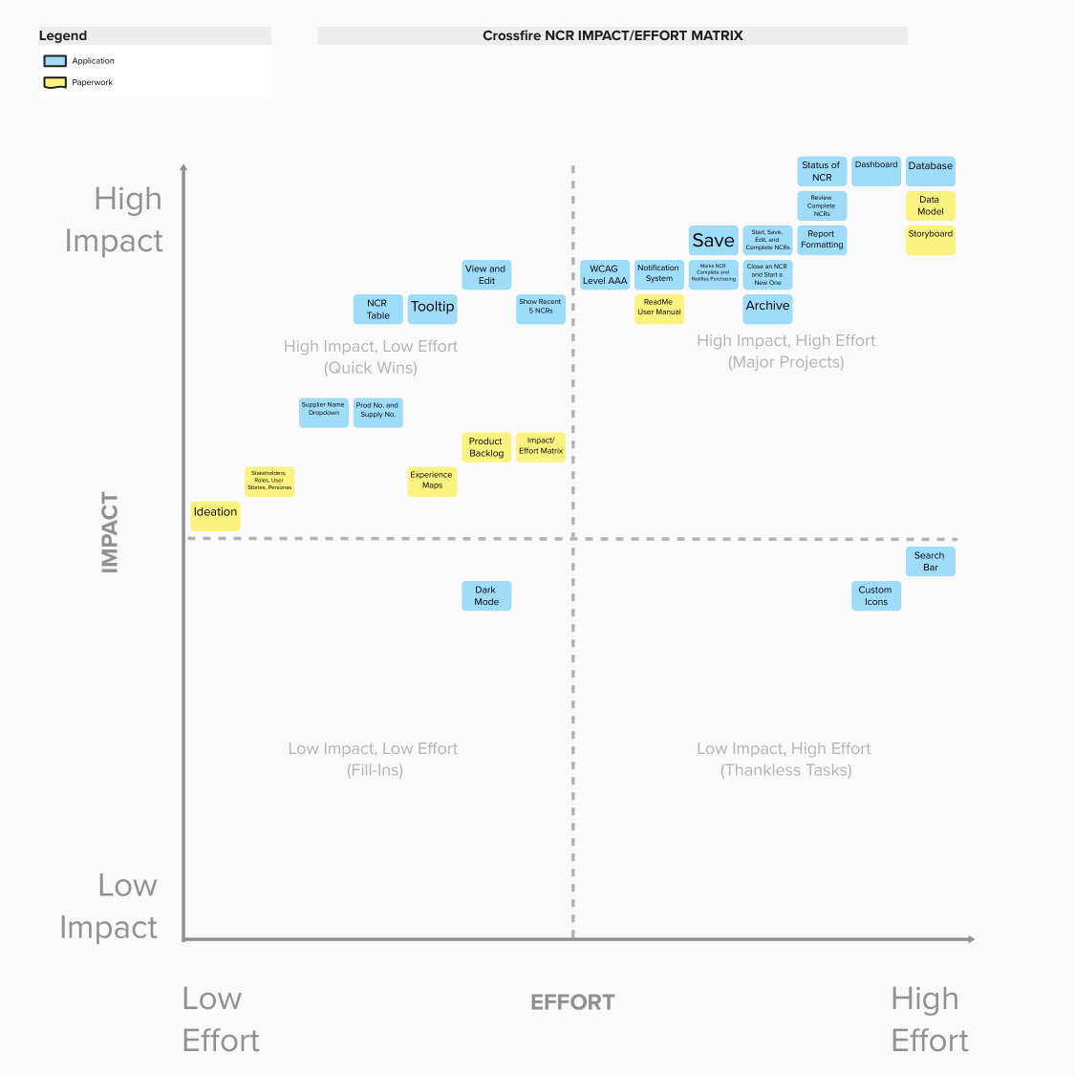

Slide 9
The Engineer Process Experience Maps

Slide 10
The Engineer Process Experience Maps

Slide 11
The Engineer Process Experience Maps

Slide 12
Data Model

